Slide 1

Projecting Phillies Stats 2026-2030
By Andrew Wolfe
November 2025

Slide 2

2025 Recap
2025 Overall Record: 96-66
Postseason Elimination: Lost in the NLDS to the Los Angeles Dodgers in a best-of-5 Series 3-1.
NL East Champions: Won the National East Title for the second consecutive season and earned a first-round bye.
Offensive Highlights: Kyle Schwarber finished the season with 56 HRs (2nd in the MLB and 2nd most in Phillies history). Trea Turned led the MLB in batting average (0.304). Both are 2025 Silver Slugger Finalists.
Defensive Highlights: Cristopher Sanchez finished the best season of his career and was a Cy-Young candidate. He led the league in innings pitched and finished with career-highs in K/9 and game appearances.
2026 Free Agents: Important players, such as Kyle Schwarber, J.T. Realmuto, and Ranger Suárez, loom as free-agents for the upcoming season.

Slide 3
Executive Summary
Objective: Project future value of some of the most valuable Philadelphia Phillies and impending free-agents. These players include Bryce Harper, Kyle Schwarber (FA), J.T. Realmuto (FA), Alec Bohm, and Trea Turner.
Data Inputs: The data inserted into our model includes player-level advanced batting stats, such as K%, xBA, xOBP, barrel rate, hard hit%, sweet spot%, Age, xISO, etc. The target variables are hitting metrics including AVG, OBP, SLG, OPS, xwOBA, and xSLG.
Modeling: A multioutput linear regression model was used to predict each player’s current/future performance using the feature inputs. The input features were normalized and scaled for standardization purposes.
Trend Estimation and Monte Carlo Simulation: To best calculate and estimate yearly improvement/decline, I calculated a trend score using a regression slope and recent player performance stats. A positive slope indicated a player whose performance was improving while a negative slope indicated a declining player. Moreover, I used a Monte Carlo simulation to project each player’s performance over the next 5 seasons. About 2000 simulations were used and each simulation would build off the yearly trend and as well as ‘noise’ (random variance in performance year-to-year). From this, a mean projection and 99% confidence interval was created.
Visualization: A line chart depicting each player’s predicted low, high, and average statistics for the next 5 seasons was produced. The chart combines each player’s historical data with future projections and was benchmarked against other MLB players (using percentiles).
Next Steps: As all models do, this will need to be improved daily and hopefully continue building off
each other. The purpose of this project is to help contract evaluation and team performance in the future.

Slide 4
Metric Definitions
Metric | Definition
k_percent | Percentage of at-bats that resulted in a strikeout.
bb_percent | Percentage of at-bats that resulted in a walk.
swing_percent | Percentage of pitches faced that resulted in a swing.
whiff_percent | Percentage of swings that did not make contact with the incoming pitch.
barrel_batted_rate | Percent of batted balls that resulted with the perfect combination of exit velocity and launch angle
hard_hit_percent | Percent of batted balls that were hit with an exit velocity of 95 mph or higher.
sweet_spot_percent | Percent of batted balls that resulted in being hit in the sweet spot of the bat, The sweet spot is classified as a launch angle ranging from 8 to 32 degrees.
solidcontact_percent | Percent of batted balls that made “solid” contact.
poorlyweak_percent | Percent of batted balls that made “weak” contact.
avg_bat_speed | Average bat speed of the top 90% of a players’ swing.
flareburner_percent | Percent of batted balls that are “flared” or hit with a low launch angle.
groundballs_percent | Percentage of batted balls that resulted in a groundball.
Metric | Definition
AVG | Number of hits / number of at-bats
OBS | Number of times the batter reaches base / number of at-bats
SLG | Measures a player's batting power. Equal to (1*# of singles + 2* # of doubles + 3*# of triples + 4* # of homeruns) / at-bats
OPS | OBS + SLG
xobp | Expected on-base percentage,
xba | Expected batting average. Measures the likelihood that a batted ball will become a hit.
xiso | Expected isolate power. Isolated Power (ISO) measures the raw power of a hitter by only taking extra base hits into account.
xSLG | Expected slug percentage. Formulated using exit velocity, launch angle, and sprint speed.
woba | Weighted on-base average. Accounts for how a player reached a base. The value for each base is determined by how much the event was worth in relation to projected runs scored.
xwoba | Expected weighted on-base average. Factors into account weighted on-base average with exit velocity, launch angle, and sprint speed.
babip | Batting average of balls in play. How often a batted ball resulted in a hit (excludes HRs).
Age | The age of the player.
Metric Information and Data is from Baseball Savant and Statcast

Slide 5
Bryce Harper
Season | AVG | OBP | SLG | OPS | xSLG | xwOBA
2025 | 0.261 | 0.357 | 0.487 | 0.844 | 0.512 | 0.379
2026 | 0.261 | 0.356 | 0.485 | 0.845 | 0.512 | 0.379
2027 | 0.257 | 0.350 | 0.477 | 0.829 | 0.502 | 0.371
2028 | 0.242 | 0.330 | 0.449 | 0.782 | 0.472 | 0.349
2029 | 0.218 | 0.299 | 0.406 | 0.705 | 0.428 | 0.316
2030 | 0.189 | 0.258 | 0.352 | 0.612 | 0.369 | 0.273
Consistent Peak Years (2026-2027): He still has the ability for top-tier production, as he continues to show great plate discipline and power (high OPS, xSLG, and xwOBA).
Mid-Decade Dip (2028-2029): Expected stats (xSLG and xwOBA) begin to show glimpses of decline combined with ability to slug.
Area for Growth (2030+): While Bryce’s numbers are expected to dip by 2030, his prior track record and natural ability indicate the potential for him to make the necessary changes to prevent this from occurring.

Slide 6
Kyle Schwarber
Season | AVG | OBP | SLG | OPS | xSLG | xwOBA
2025 | 0.240 | 0.365 | 0.563 | 0.928 | 0.601 | 0.414
2026 | 0.239 | 0.365 | 0.562 | 0.927 | 0.601 | 0.414
2027 | 0.235 | 0.358 | 0.554 | 0.913 | 0.590 | 0.407
2028 | 0.222 | 0.339 | 0.524 | 0.862 | 0.557 | 0.385
2029 | 0.201 | 0.307 | 0.475 | 0.780 | 0.505 | 0.348
2030 | 0.174 | 0.266 | 0.411 | 0.678 | 0.438 | 0.302
Elite Ability to Slug (2026-2028): Kyle still demonstrates the ability to hit for power, posting high xSLG, xwOBA, and OPS.
Consistent Power, Decline on the Way (2028-2029): Still an above-average power hitter with high expected values. Contact and on-base abilities begin to decline.
Areas for Growth/Retirement Expected (2030+): Kyle’s numbers are projected to heavily decline in all categories in 2030. This makes sense as he will be 37 years old during the 2030 season.

Slide 7
J.T. Realmuto
Season | AVG | OBP | SLG | OPS | xSLG | xwOBA
2025 | 0.257 | 0.315 | 0.384 | 0.700 | 0.422 | 0.323
2026 | 0.257 | 0.314 | 0.383 | 0.699 | 0.423 | 0.323
2027 | 0.233 | 0.284 | 0.346 | 0.635 | 0.381 | 0.292
2028 | 0.201 | 0.246 | 0.301 | 0.550 | 0.332 | 0.253
2029 | 0.167 | 0.204 | 0.250 | 0.455 | 0.274 | 0.210
2030 | 0.132 | 0.162 | 0.197 | 0.361 | 0.217 | 0.166
Consistency (2026): Similar stats projected in 2026 compared to 2025, with solid offensive output and consistency.
Decline (2027-2029): Large projected decline in terms of contact, power, and on-base metrics combined with expected numbers as well.
Areas for Growth/Retirement Expected (2030+): Severe decline projected in 2030, but high chance of retirement by 2030.

Slide 8
Trea Turner
Season | AVG | OBP | SLG | OPS | xSLG | xwOBA
2025 | 0.304 | 0.355 | 0.457 | 0.812 | 0.416 | 0.325
2026 | 0.303 | 0.354 | 0.456 | 0.811 | 0.416 | 0.324
2027 | 0.298 | 0.349 | 0.449 | 0.798 | 0.408 | 0.320
2028 | 0.282 | 0.329 | 0.423 | 0.752 | 0.385 | 0.301
2029 | 0.255 | 0.297 | 0.382 | 0.680 | 0.348 | 0.273
2030 | 0.220 | 0.257 | 0.331 | 0.589 | 0.301 | 0.236
Consistent and Strong Prime (2026-2028): Productive hitter with a strong batting average and consistent ability to mix in power/contact. Above-average expected metrics as well.
Decline (2029): Statistics begin to drop in 2029 with diminished contact and power ability. OPS, xwOBA, and xSLG fall.
Areas for Growth (2030): His worst statistical season is projected in 2030 – 5 seasons down the line, but due to his all-star caliber performance in the past, I would never doubt his ability to make the necessary adjustments to prevent this from occurring.

Slide 9
Alec Bohm
Season | AVG | OBP | SLG | OPS | xSLG | xwOBA
2025 | 0.287 | 0.331 | 0.409 | 0.741 | 0.426 | 0.332
2026 | 0.286 | 0.331 | 0.409 | 0.742 | 0.425 | 0.331
2027 | 0.286 | 0.331 | 0.410 | 0.740 | 0.424 | 0.331
2028 | 0.285 | 0.330 | 0.409 | 0.741 | 0.425 | 0.330
2029 | 0.285 | 0.330 | 0.409 | 0.738 | 0.424 | 0.331
2030 | 0.285 | 0.330 | 0.408 | 0.740 | 0.424 | 0.330
Consistency (2026-2029): Stats relatively do not change significantly over the next 5 seasons. Consistent power and expected metrics.
Optimism (2030+): Stats in 2030 are very similar to those in 2026, indicating his reliability to contribute and be dependable year in and year out for the next 5 seasons.

Slide 10
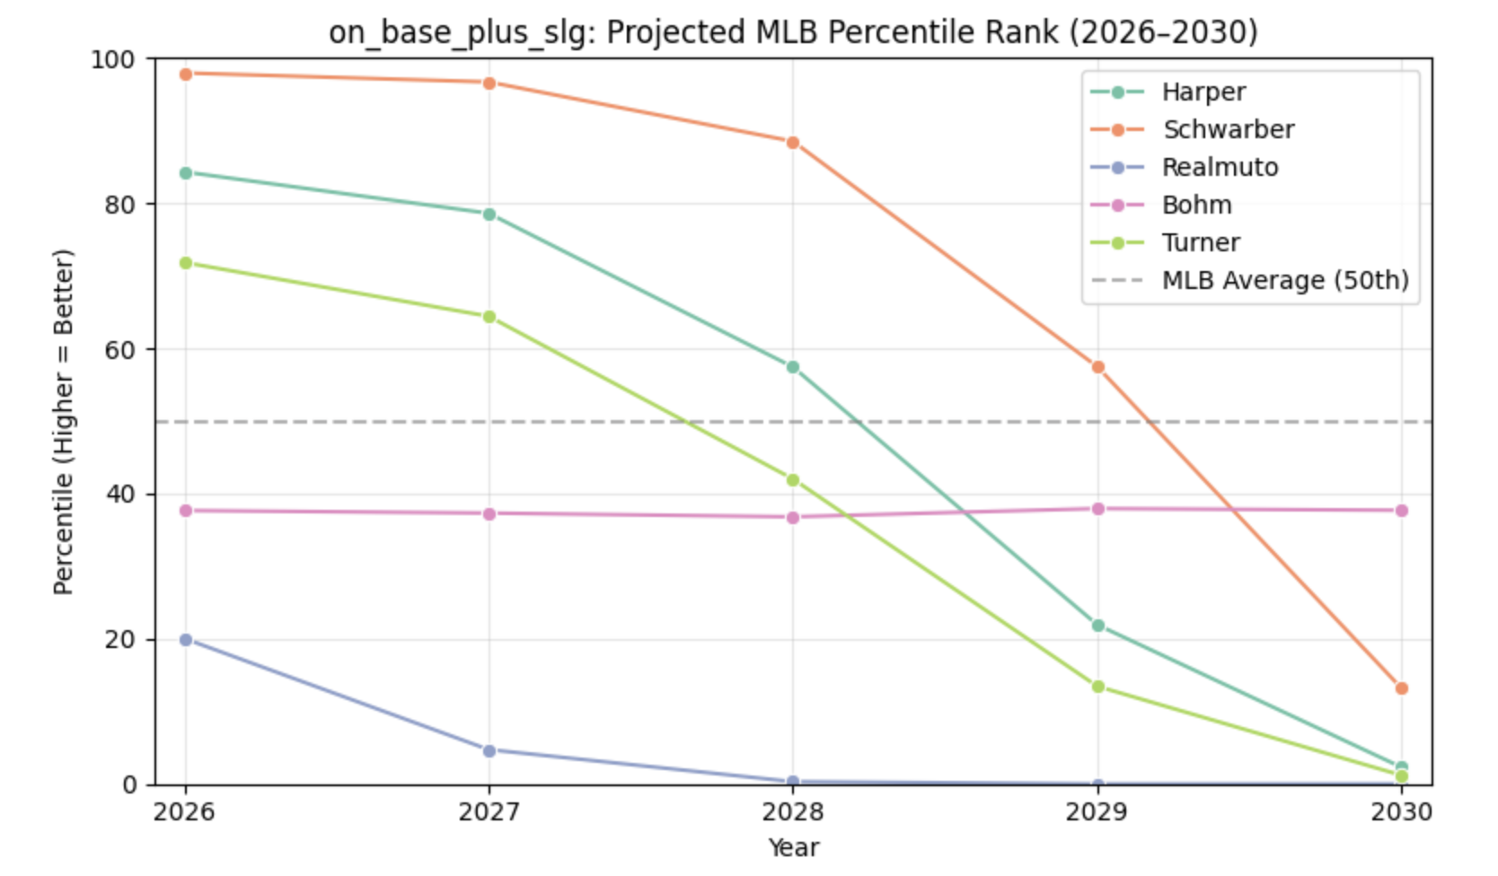
Percentile Rankings: OPS
Harper and Schwarber are High Contributors: Harper, Turner, and Schwarber are both projected to be ranked among the best in the MLB in terms of OPS in the MLB until 2028.
Stability: Bohm remains consistent throughout the next 5 years with slightly below average OPS numbers.

Slide 11
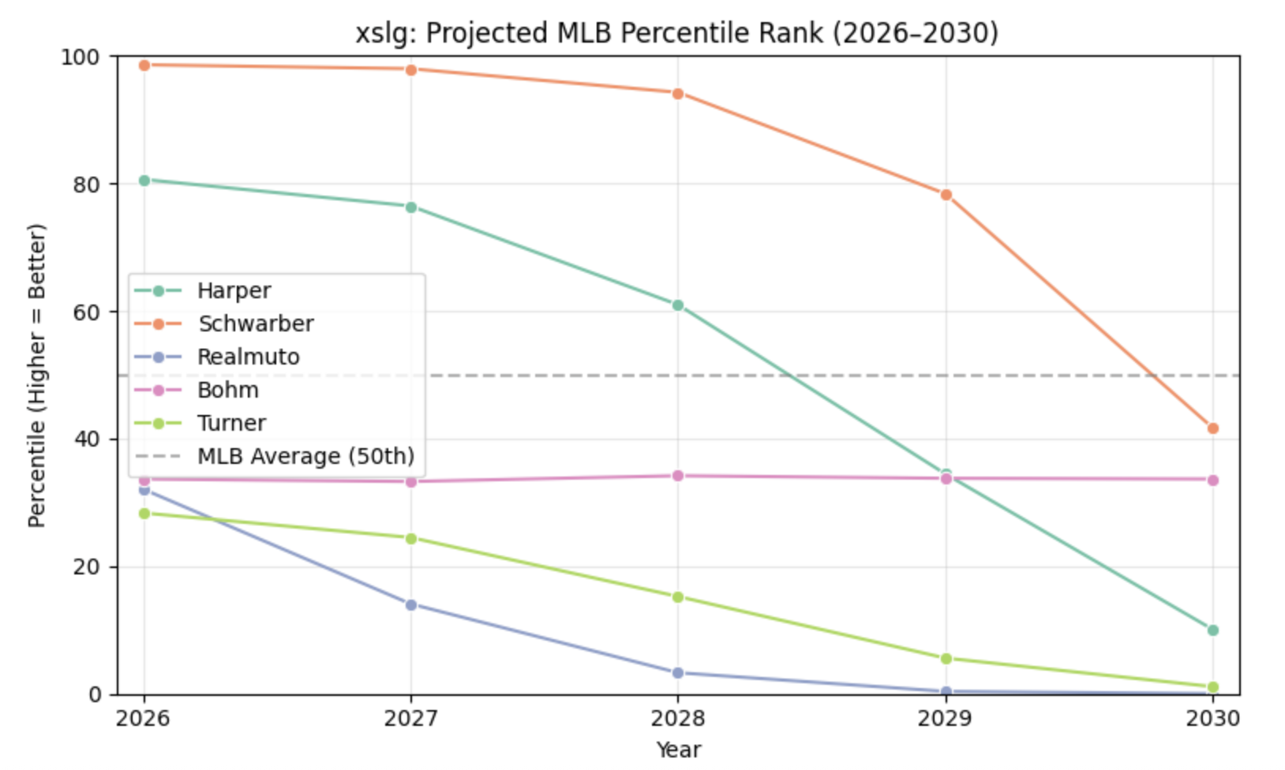
Percentile Rankings: xSLG
Harper and Schwarber are High Contributors Again: Harper and Schwarber are both projected to be ranked among the best in the MLB in terms of xSLG in the MLB until 2029/2030, representing their consistent power ability.
Decline from Realmuto and Turner: J.T. Realmuto and Trea Turner are projected to have a significant decline from 2026-2030 with their power and ability to slug.

Slide 12
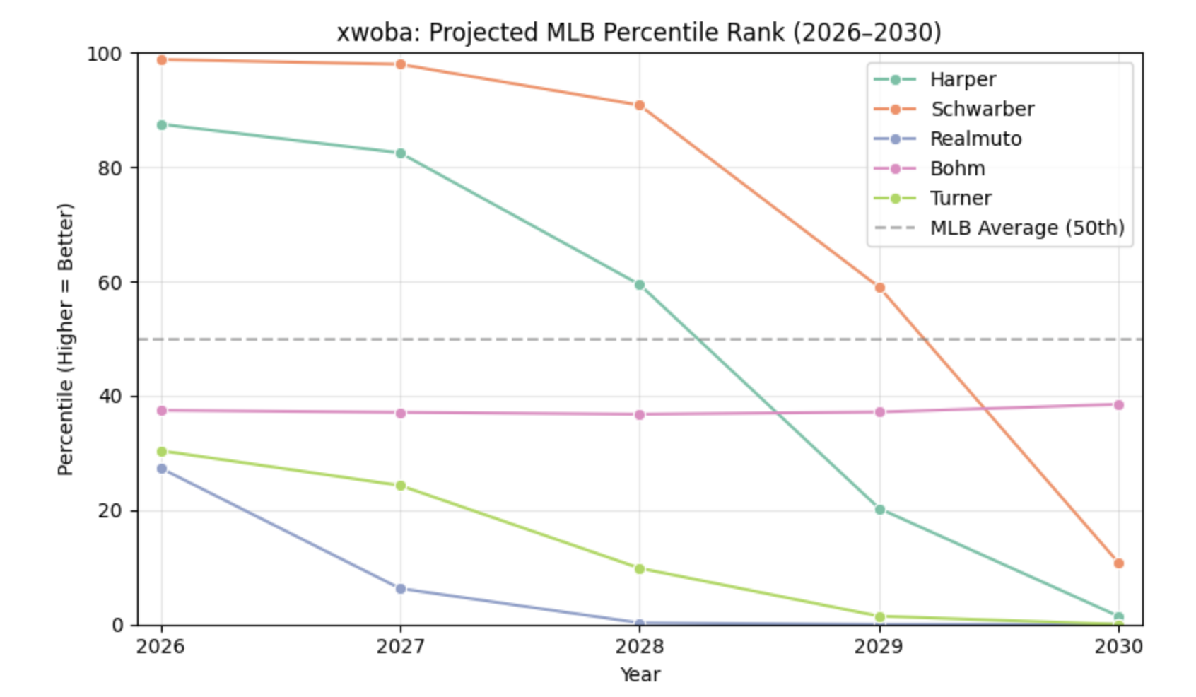
Percentile Rankings: xwOBA
Harper and Schwarber Show High Consistency: Harper and Schwarber are both projected again to be among the best in the MLB in xwOBA, demonstrating their consistent power and contact ability for years to come.
Decline from Realmuto and Turner: J.T. Realmuto and Trea Turner are projected to have a significant decline from 2026-2030 with their power and contact.

Slide 13
Summary & Key Takeaways
Summary:
Advanced metrics and age were used by a multioutput regression model to project offensive performance for MLB players during the next five seasons. I specifically filtered and looked at certain Phillies, such as Bryce Harper, Kyle Schwarber, J.T. Realmuto, Alec Bohm, and Trea Turner.
To generate 99% confidence intervals for each player’s expected outcomes, Monte Carlo simulations were used. This also brought volatility, age decline, recent player trends, and uncertainty into the player projections.
The player projections and statistics were compared and benchmarked against all other MLB players using percentiles. This allows us to really put meaning into the projected statistics and assess performance in regards to other MLB players.
Key Takeaways:
Aging Curve: Veteran players, such as Bryce Harper, Kyle Schwarber, Trea Turner, and J.T. Realmuto, all show signs of decline in terms of power and contact capability towards the end of 2028-2030.
Consistency with Low Projected Growth: Alec Bohm is projected to remain consistent over the next couple of years, but shows limited growth and breakout potential if no major mechanical changes are made in the future.
Offensive Window Close to Closing with this Core: The model indicates that the Phillies core still can peak with these players until 2027-2028. It might be in the best interest for the Phillies to acquire, draft, or develop younger high-impactful players who can make up for the projected decline of some of its current players in the years to come.
Next Steps:
Please keep in mind that this project only looks at the offensive output of the players and did not factor defensive play. If it did so, we would expect the overall projections of J.T. Realmuto and Bryce Harper to improve as they are some of the best defensive players in the MLB.
Incorporate WAR, stadium environments, defensive output, and lineup-level statistics to continue assessing player value and
improving the model in the future.

